Slide 1
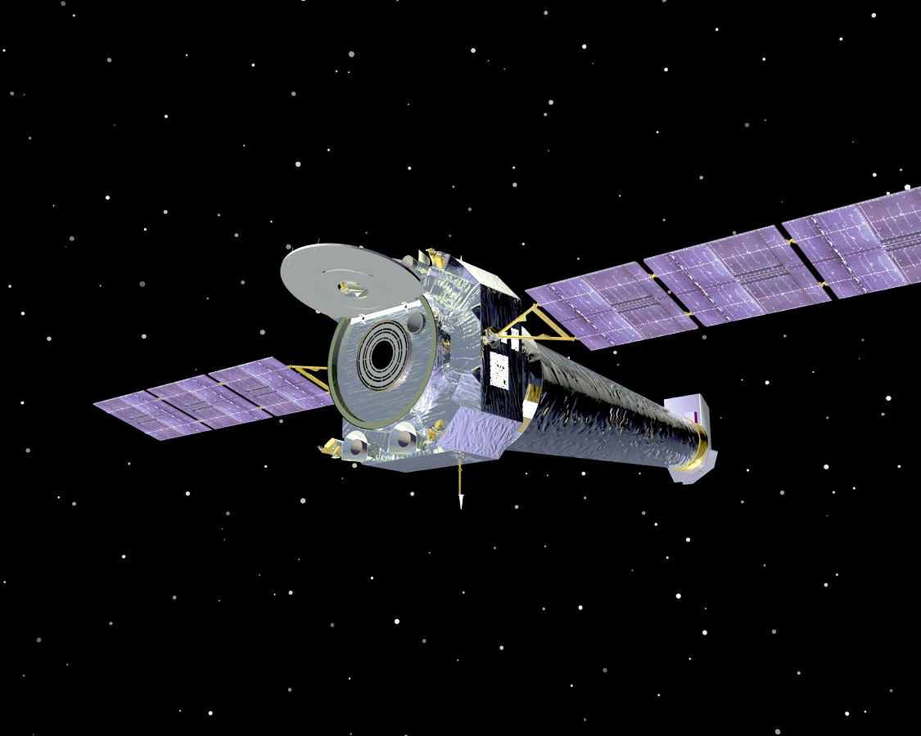
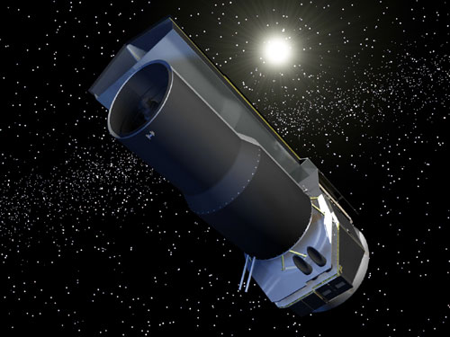
Satellite Communication
MBEYA UNIVESITY OF SCIENCE AND COMMUNICATION
ET8412

Slide 2
Introduction
Satellite communication has become a part of everyday life. We make international as easily as local calls, see live football matches and other events.
This capability to exchange information in made possible by satellite.
It stretches back to an era when the term satellite was merely an idea conceived by a few inspired individuals.
These pioneers included authors such as Arthur C. Clark, who in 1945 fostered the idea of a worldwide satellite system.

Slide 3
In most instances, satellite systems offer more flexibility than submarine cables, buried underground cable, microwave radio or optical fiber system.

Slide 4
What exactly is a satellite?
The word satellite originated from the Latin word “Satellit”- meaning an attendant, one who is constantly hovering around & attending to a “master” or big man.
For our own purposes however a satellite is simply any body that moves around another (usually much larger) one in a mathematically predictable path called an orbit.

Slide 5
What is satellite communication?
A satellite communication is basically an electronic communication package placed in orbit whose prime objective is to initiate or assist another through space.
A communication satellite is a station in space that is used for telecommunication, radio and television signals.
The first satellite with radio transmitter was in 1957.

Slide 6
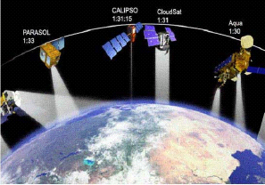
Communication Satellites

Slide 7
History of satellite
The concept of using object in space to reflect signals for communication was proved by Naval Research Lab in Washington D.C. when it use the Moon to establish a very low data rate link between Washington and Hawaii in late 1940’s.
Russian started the Space age by successfully launching SPUTNIK the first artificial spacecraft to orbit the earth, which transmitted telemetry information for 21 days in Oct. 1957.

Slide 8
CONT…
The American followed by launching an experimental satellite EXPLORER In 1958.
In 1960 two satellite were deployed “Echo” & “Courier”
In 1962 AT&T launched Telstar I, the first satellite to receive and transmit simultaneously.
Telstar II was successfully launched in 1963. It was used for telephone, television, facsimile and data transmission.
There are about 750 satellites in the space, most of them are used for communication.

Slide 9
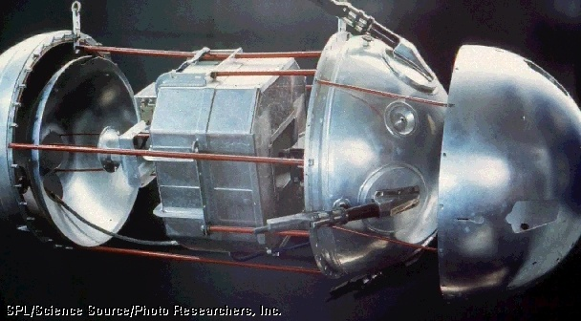
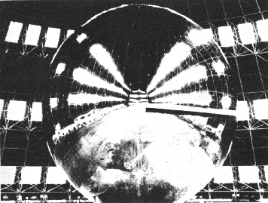
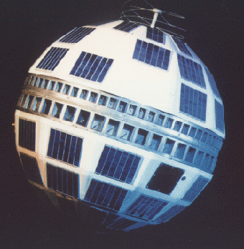
Satellite Pictures
October 1957, the first artificial satellite Sputnik -I was launched by former Soviet Russia.
The first artificial passive satellite Echo-I of NASA was launched in August 1960.
In July 1962 active satellite Telstar was developed and launched

Slide 10
How Satellites are used
Service Types
Fixed Service Satellites (FSS)
Example: Point to Point Communication
Broadcast Service Satellites (BSS)
Example: Satellite Television/Radio
Also called Direct Broadcast Service (DBS).
Mobile Service Satellites (MSS)
Example: Satellite Phones

Slide 11
Application Example
Telecommunications
Military communications
Navigation systems
Remote sensing and surveillance
Radio / Television Broadcasting
Astronomical research
Weather observation

Slide 12
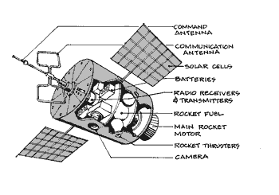
Components of a satellite

Slide 13
Types of Satellites
Passive satellite
A passive satellite is one that simply reflects a signal back to earth ; there are no gain devices on board to amplify or repeat the signal. These type of satellites simply reflects or scatters the micro wave signal back to another station.
An advantage of passive satellites is that they do not require sophisticated electronic equipment on board.
Example: military and non profitable services.

Slide 14
Satellite Communications Needs
Space vehicle used as communications platform
(Earth-Space-Earth, Space-Earth, Space-Space)
Space vehicle used as sensor platform with communications
Ground station(s) (Tx/Rx)
Ground receivers (Rx only)

Slide 15
Major problems for satellites
Positioning in orbit
Stability
Power
Communications
Harsh environment

Slide 16
Advantages of Satellite
High channel capacity (>100 Mb/s)
Low error rates (P_{e} ~ 10⁻⁶)
Stable cost environment (no long-distance cables or national boundaries)
Wide area coverage (whole North America, for instance)
Coverage can be shaped by antenna patterns

Slide 17
Disadvantages of Satellite
Expensive to launch
Expensive ground stations required
Cannot be maintained
Limited frequency spectrum
Limited orbital space (geosynchronous)
Constant ground monitoring required for positioning and operational control

Slide 18
CONT…
Active satellite
An active satellite is one that electronically repeats a signal back to Earth (receive, amplifies and retransmits the signal).
It is one in which the signal is amplified and its frequency changed by transponder, before it sent back to earth.
Example: communication, broadcasting satellites.

Slide 19
Orbital satellites
The satellites mentioned – thus far are called orbital or nonsynchronous satellites.
Nonsynchronous satellites rotate around Earth in a low-altitude elliptical or circular pattern.
One of the more interesting orbital satellite system is the Soviet Molniya system.
This satellites are used for television broadcasting and are presently the only nonsynchronous-orbit commercial satellite system in use.

Slide 20
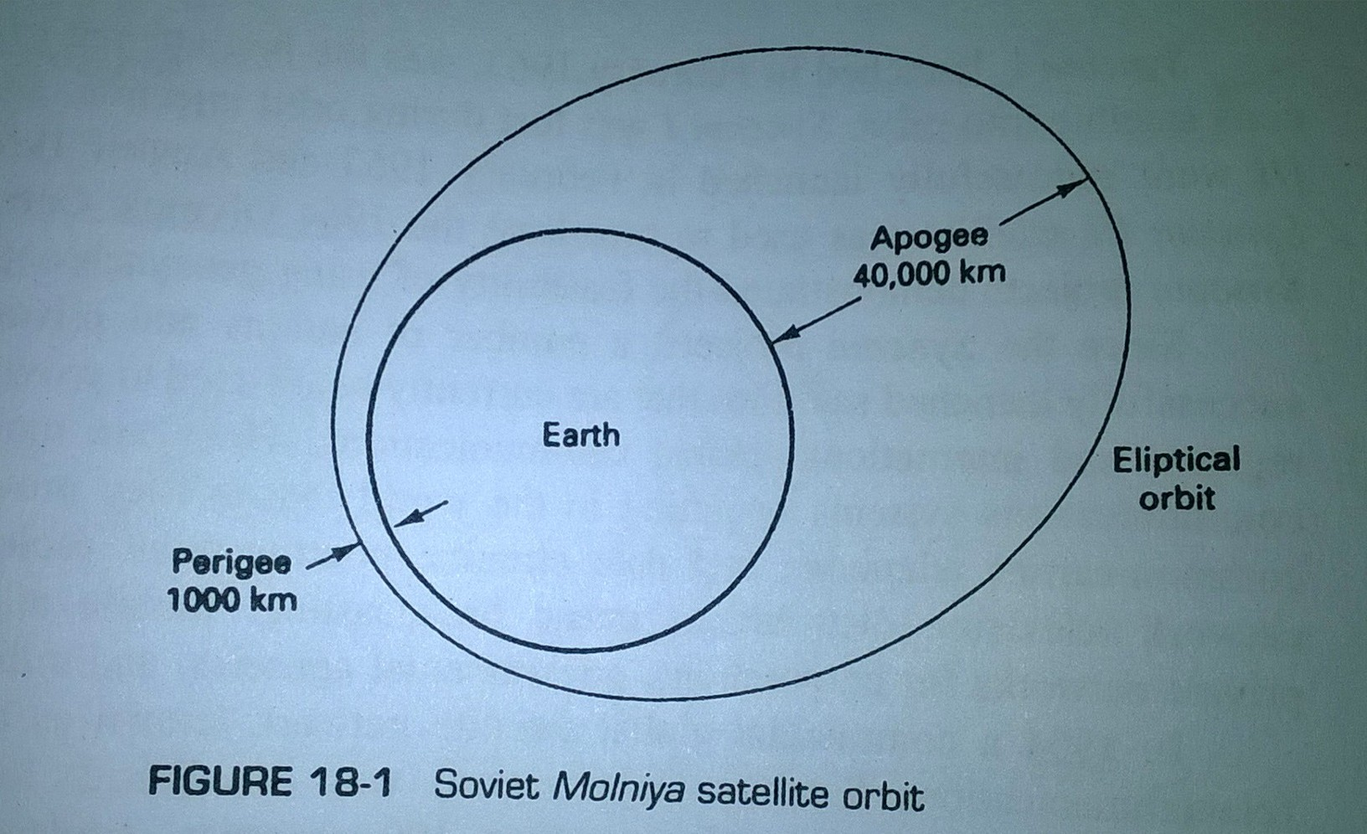
Soviet Molniya satellite orbit

Slide 21
The apogee is the farthest distance from Earth a satellite orbit reaches, the perigee is the minimum distance, and the line of apsides is the line joining the perigee and apogee through the center of Earth.

Slide 22
Geostationary Satellites
Geostationary or geosynchronous satellites are satellites that orbit in a circular pattern with an angular velocity equal to that of Earth.
Consequently, they remain in a fixed position in respect to a given point on Earth. The orbital time of a geosynchronous satellite is 24 h, the same as Earth.
An obvious advantage is they are available to all the earth stations within their shadow 100% of the time.
Disadvantage is they require sophisticated and heavy propulsion devices on board to keep in fixed orbit.

Slide 23
Orbital patterns
Satellite orbits are also classified in terms of the orbital height. These are:
LEO- Low Earth Orbit
MEO- Medium Earth Orbit
GEO- Geostationary Earth Orbit

Slide 24
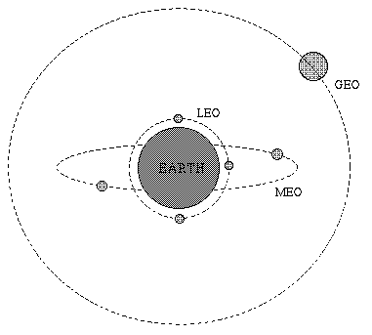
LEO, MEO & GEO

Slide 25
Differences
GEO | MEO | LEO
These are very far away from Earth. | These are little far from Earth. | These are much closer to Earth
These are placed at the height in between 19000 mi to 25ooo mi from the Earth surface.36000KM | These are placed at the height in between 6000 mi to 12ooo mi from the Earth surface. 10,000 to 20,000 km | These are placed at the height in between 100 mi to 3oo mi from the Earth surface. 160 km and 1,600 km
Revolves with same angular velocity as the Earth rotation | Revolves faster than Earth | Don’t stay in fixed position relative to the surface
Maximum time rotation around 23 H: 56 M: 4S | Visible for a particular period of time, usually between 2 to 8 hours | Visible for 15 to 30 mins each pass. 1.5 hours rotate around the entire earth
Larger coverage area, a single satellite can cover 42% of earth | Not as much as Geo Satellite | Not as much as Geo and MEO satellite
Larger delay compared to other orbits | Delay is less compared to GEO orbit | Delay is lesser than GEO and MEO orbits

Slide 26
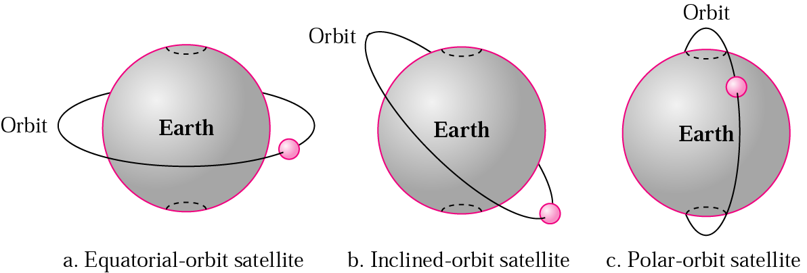
Satellite Paths
There are three paths that a satellite may take as it rotates around the Earth.

Slide 27
Equatorial Orbit: When the satellite rotates in an orbit above the equator, it is called an equatorial orbit.
Polar Orbit: When the satellite rotates in an orbit that takes it over the north and south poles, it is called a polar orbit.
Inclined Orbit: Any other orbital path is called an inclined orbit.

Slide 28
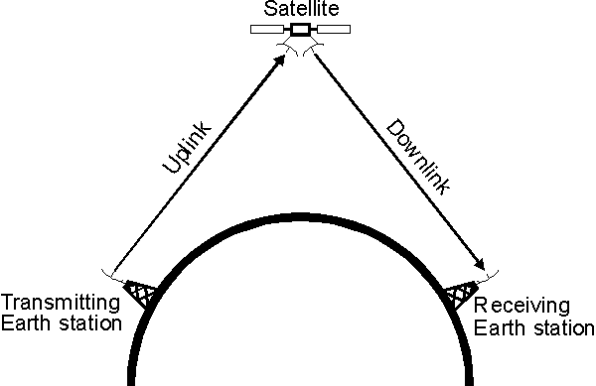
Satellite communication picture

Slide 29
Uplinks and Downlinks
According to the FCC, an uplink is the “transmission power that carries a signal… from its Earth station source up to a satellite; a downlink…. includes the satellite itself the receiving Earth station and the signal transmitted downward between the two.”
The uplink refers to the transmission from the Earth station to the satellite and the downlink is the transmission from the satellite to the Earth station.

Slide 30
Radiation Patterns: Footprints
The area of Earth covered by a satellite depends on the location of the satellite in its geosynchronous orbit, its carrier frequency and the gain of its antennas.
The geographical representation of a satellite antenna’s radiation pattern is called a footprint.

Slide 31
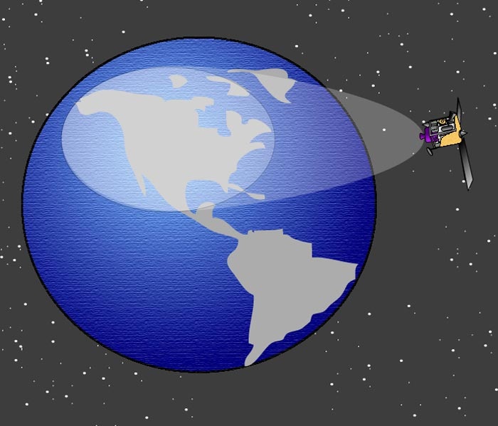
Footprints

Slide 32
Footprint Categories
The radiation pattern from a satellite antenna may be categorized as either spot, zonal or earth.
The radiation patterns of earth coverage antennas have a beamwidth of approximately 17 degree and include coverage of approximately one-third of Earth’s surface.
Zonal coverage includes an area less than one-third of Earth’s surface.
Spot beams concentrate the radiated power in a very small geographic area.

Slide 33
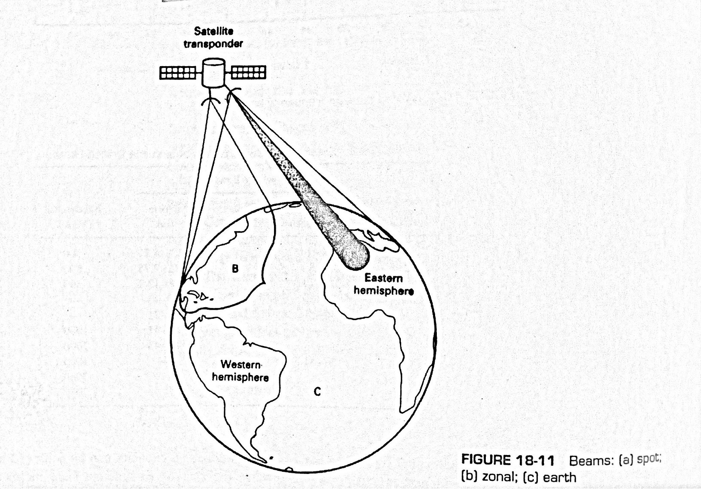
Beams: spot, zonal or earth

Slide 34
Satellite Transmission Bands
Frequency Band | Downlink | Uplink
C | 3.7-4.2 GHz | 5.92-6.42 GHz
Ku | 11.7-12.2 GHz | 14.0-14.5 GHz
Ka | 17.7-21.2 GHz | 27.5-31.0 GHz
The C band is the most frequently used. The Ka and Ku bands are reserved exclusively for satellite communication but are subject to rain attenuation

Slide 35
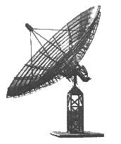
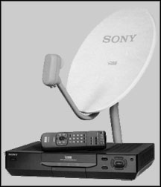
Satellite Frequency Bands and Antennas (Dishes)
C-Band Ku-Band
Most commonly used bands: C-band (4 to 8 GHz) , Ku-band (11 to 17 GHz) , and Ka-band (20 to 30 GHz ).

Slide 36
Satellite System
Essentially, a satellite system consists of 3 sections:
An up-link
A satellite transponder
And a down-link

Slide 37
Up-link Model
The primary component within the up-link section of a satellite system is the earth station transmitter.
A typical earth station transmitter consists of an IF modulator, an IF-to-RF microwave up-converter, a high-power amplifier (HPA), and some means of band limiting the final output spectrum.

Slide 38
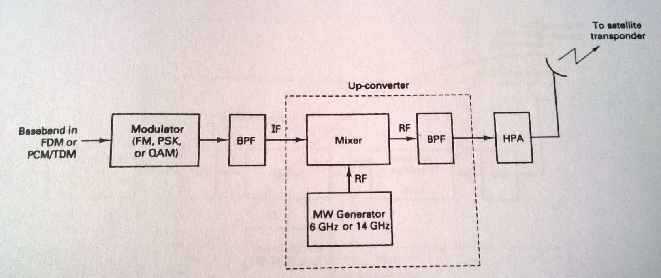
Satellite up-link model

Slide 39
Transponder
A typical satellite transponder consists of an input bandlimiting device (BPF), an input low-noise amplifier (LNA), a frequency translator, a low level power amplifier, and an output bandbass filter.

Slide 40
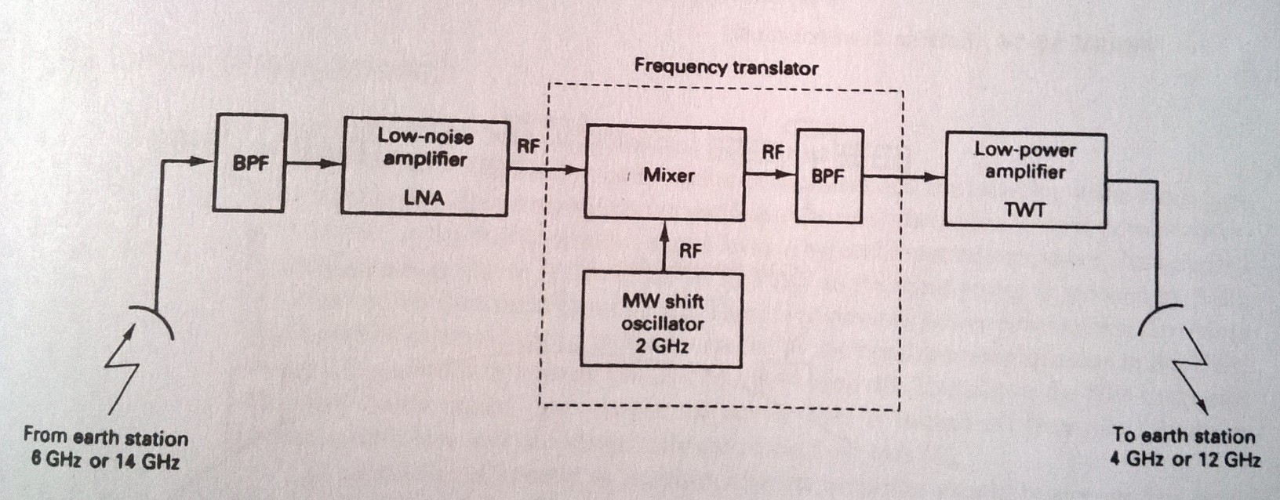
Satellite Transponder

Slide 41
Down-link Model
An earth station receiver includes an input BPF, an LNA, and an RF-to-IF down-converter.

Slide 42
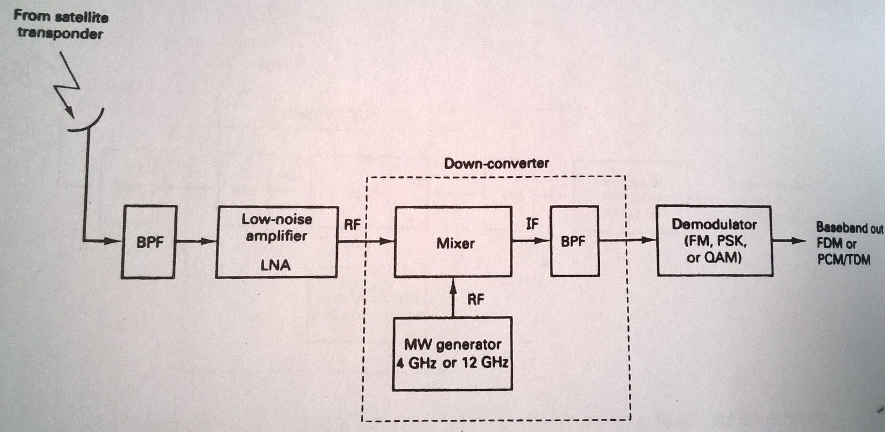
Satellite down-link model

Slide 43
Cross-links
Occasionally, there is an application where it is necessary to communicate between satellites. This is done using satellite cross-links or intersatellite links (ISLs).

Slide 44
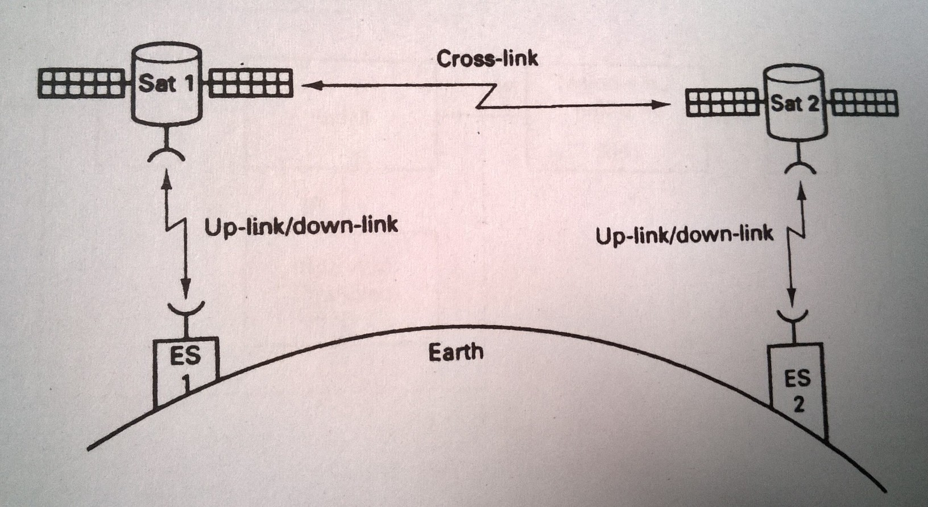
Cross-links

